Slide 1
Topic: Algebra Review
EQ: What are the important algebraic definitions?

Slide 2
Learning Intentions
Students will be able to
Define the key words used throughout our algebra unit

Slide 3
24
7
30
Algebra Review
Date:
EQ – What are the important algebraic definitions?
15 mins Match up pair activity.
Work in pairs but you will each have a template to glue in HERE BUT MAKE SURE THAT IT CAN BE FOLDED TO LEAVE ROOM FOR MORE NOTES

Slide 4
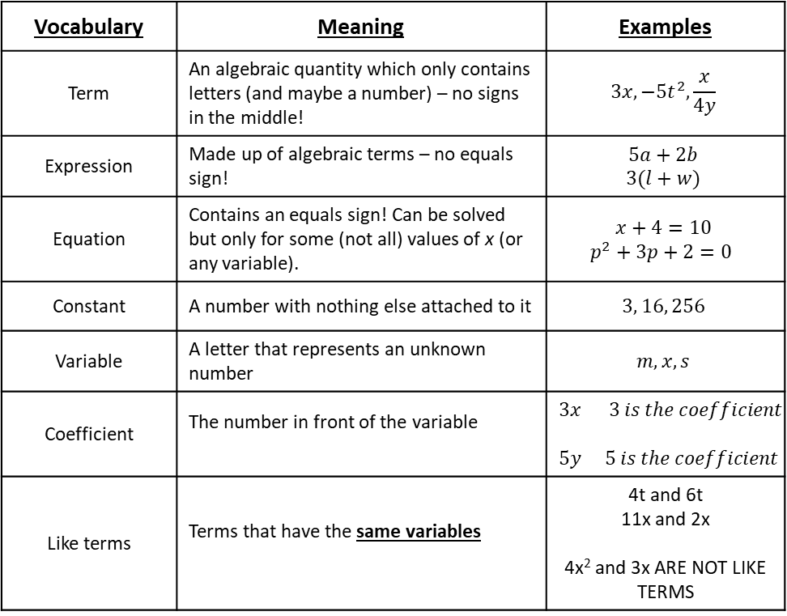
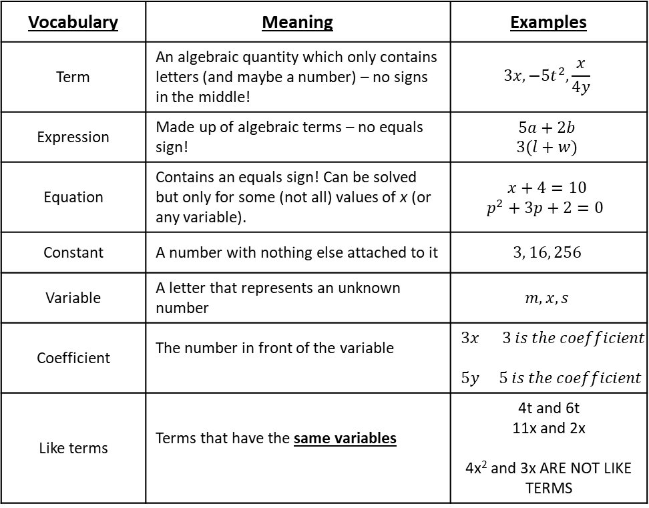
Algebra - Vocabulary
Algebra - Vocabulary
Vocabulary | Meaning | Examples
Term | An algebraic quantity which only contains letters (and maybe a number) – no signs in the middle! | $$3x, −5t^{2},\frac{x}{4y}$$
Expression | Made up of algebraic terms – no equals sign! | $$5a+2b$$ $$3(l+w)$$
Equation | Contains an equals sign! Can be solved but only for some (not all) values of x (or any variable). | $$x+4=10$$ $$p^{2}+3p+2=0$$
Constant | A number with nothing else attached to it | $$3, 16, 256$$
Variable | A letter that represents an unknown number | $$m, x, s$$
Coefficient | The number in front of the variable | $$3x 3 is the coefficient$$ $5y 5 is the coefficient$
Like terms | Terms that have the same variables | 4t and 6t 11x and 2x 4x² and 3x ARE NOT LIKE TERMS
Vocabulary | Meaning | Examples
Term | An algebraic quantity which only contains letters (and maybe a number) – no signs in the middle! | $$3x, −5t^{2},\frac{x}{4y}$$
Expression | Made up of algebraic terms – no equals sign! | $$5a+2b$$ $$3(l+w)$$
Equation | Contains an equals sign! Can be solved but only for some (not all) values of x (or any variable). | $$x+4=10$$ $$p^{2}+3p+2=0$$
Constant | A number with nothing else attached to it | $$3, 16, 256$$
Variable | A letter that represents an unknown number | $$m, x, s$$
Coefficient | The number in front of the variable | $$3x 3 is the coefficient$$ $5y 5 is the coefficient$
Like terms | Terms that have the same variables | 4t and 6t 11x and 2x 4x² and 3x ARE NOT LIKE TERMS
Notes:
Cut these up prior to lesson. Students work in pairs or groups to glue in the correct order using template on next slide

Slide 5
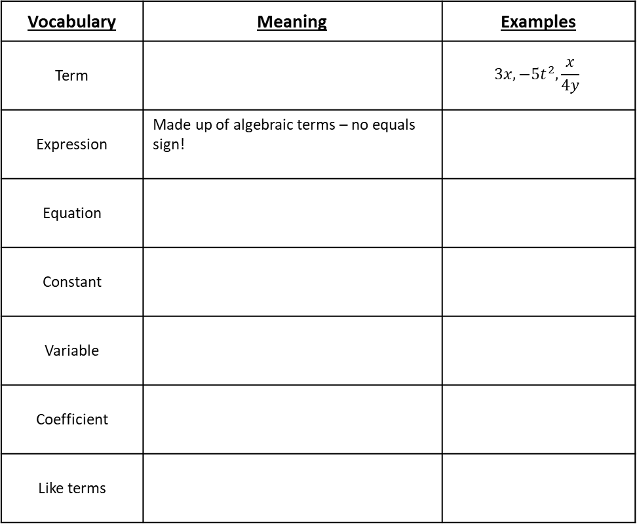
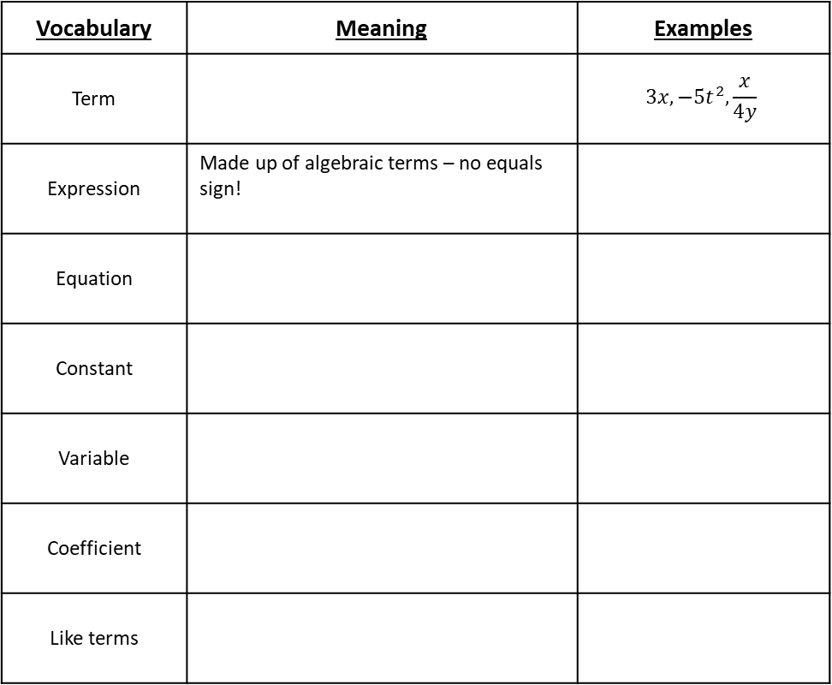
Algebra - Vocabulary
Algebra - Vocabulary
Vocabulary | Meaning | Examples
Term |  | $$3x, −5t^{2},\frac{x}{4y}$$
Expression | Made up of algebraic terms – no equals sign!
Equation
Constant
Variable
Coefficient
Like terms
Vocabulary | Meaning | Examples
Term |  | $$3x, −5t^{2},\frac{x}{4y}$$
Expression | Made up of algebraic terms – no equals sign!
Equation
Constant
Variable
Coefficient
Like terms

Slide 6
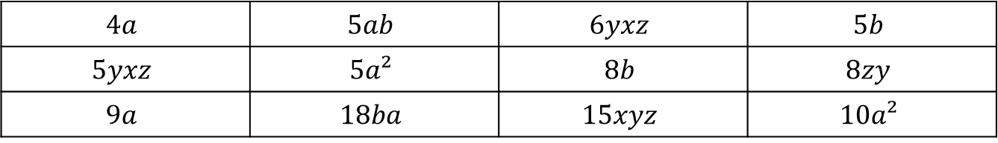
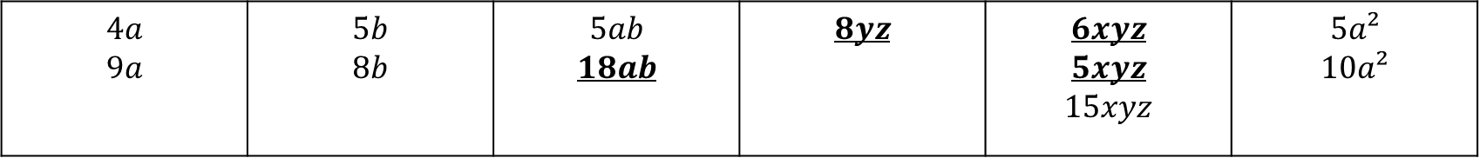
Practice: LHS
GROUP THE FOLLOWING INTO LIKE TERMS
$$4a$$ | $$5ab$$ | $$6yxz$$ | $$5b$$
$$5yxz$$ | $$5a²$$ | $$8b$$ | $$8zy$$
$$9a$$ | $$18ba$$ | $$15xyz$$ | $$10a²$$
$$4a$$ $$9a$$ | $$5b$$ $$8b$$ | $$5ab$$ $$18ab$$ | $$8yz$$ | $$6xyz$$ $$5xyz$$ $$15xyz$$ | $$5a²$$ $$10a²$$

Slide 7

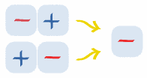
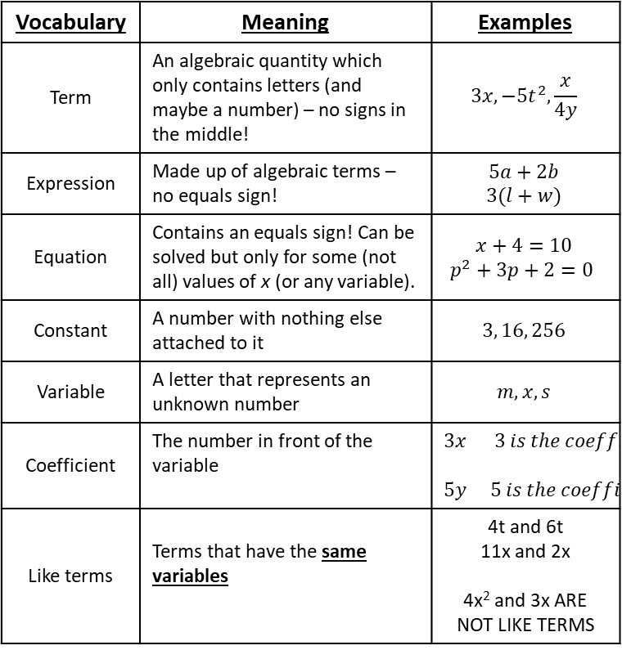
24
7
30
Algebra Review
Date:
EQ – What are the important algebraic definitions?
Vocabulary | Meaning | Examples
Term | An algebraic quantity which only contains letters (and maybe a number) – no signs in the middle! | $$3x, −5t^{2},\frac{x}{4y}$$
Expression | Made up of algebraic terms – no equals sign! | $$5a+2b$$ $$3(l+w)$$
Equation | Contains an equals sign! Can be solved but only for some (not all) values of x (or any variable). | $$x+4=10$$ $$p^{2}+3p+2=0$$
Constant | A number with nothing else attached to it | $$3, 16, 256$$
Variable | A letter that represents an unknown number | $$m, x, s$$
Coefficient | The number in front of the variable | $$3x 3 is the coefficient$$ $5y 5 is the coefficient$
Like terms | Terms that have the same variables | 4t and 6t 11x and 2x 4x² and 3x ARE NOT LIKE TERMS
Adding Positive Numbers
Adding positive numbers is just simple addition.
Subtracting Positive Numbers
Subtracting positive numbers is just simple subtraction.
Subtracting a Negative Number
Subtracting a negative number is like adding
Adding a Negative Number
Subtracting a negative number is like subtracting. SAME AS SUBTRACTING A POSITIVE

Slide 8
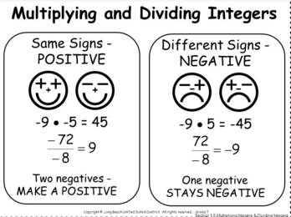
24
7
30
Algebra Review
Date:
EQ – What are the important algebraic definitions?
Don’t forget BIDMAS

Slide 9

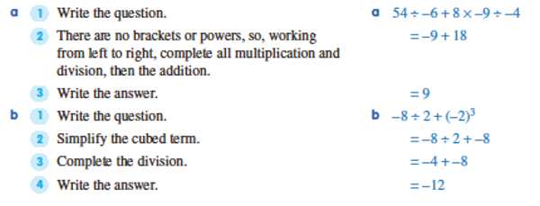
24
7
30
Algebra Review
Date:
EQ – What are the important algebraic definitions?
Worked example

Slide 10
24
7
30
Algebra Review
Date:
EQ – What are the important algebraic definitions?
Your turn
Combined operations on integers worksheet

